Slide 1
Year One Phonics Evening.

Slide 2
Phonics Screening Check
June 2020
Assess standard of phonics decoding
40 words
Two sections
Real words and pseudo (alien) words

Slide 3
Reading (blending)
sand
shop

Slide 4
Pseudo (alien) words
bain
meep

Slide 5
Terminology
Phoneme- this is the sound e.g. c, m, ch, ou. There are 44 in our
English language.
Grapheme- this is a way of writing down a sound. This may consist of
one or more letters e.g. ie as in pie, igh as in high.
Segment- this is when children pull words apart by saying the sounds
e.g. c-a-t m-oo-n f-ar-m-er

Slide 6
Terminology Continued
Blend- this is when sounds are put together to
make a word
Digraph- a grapheme containing two letters that
make one sound e.g. sh, th or vowel digraphs such as oa, ee
Trigraph- a grapheme containing three letters that make one sound e.g. igh, ear and air
Split digraph- when a vowel digraph is split by a consonant
e.g. a_e lake or i_e bike

Slide 7
Phonic sounds
s a t p
i n m d
g o c k
ck e u r
h b f ff l ll s ss
j v w x
y z zz qu
ch sh th ng
ai ee igh oa oo ar or ur ow oi ear air ure er

Slide 8
Pure sounds
It is vital that sounds are pronounced in a pure way. For example ‘f’ not ‘fuh’ and ‘s’ not ‘suh’. The reason for this is so that children can segment and blend correctly and do not add extra sounds when reading.
e.g. b-a-t-u instead of b-a-t

Slide 9
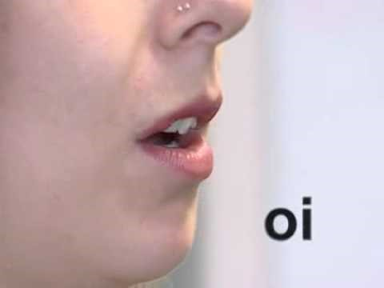
Phonics video
https://www.youtube.com/watch?v=BqhXUW_v-1s

Slide 10
How phonics works in Year One
5 differentiated groups
25 minute sessions with opportunities to read and write
Spellings are carried out in phonics groups
A new tricky word is introduced and explored daily

Slide 11
Letters and sounds
Phase 1
Exploring sounds
Phase 2
Introduction of phonemes and graphemes to pronounce and write correctly
Children start to segment and blend CVC words (consonant-vowel-consonant) e.g. b-i-g

Slide 12
Letters and sounds continued
Phase 3
Continuation of single sounds and introduction of digraphs
and trigraphs.
Children know one way of writing down all 44 phonemes.
Children know the names of letters.
Phase 4
Revision of phase 3 and consolidation through reading
and writing words that contain taught phonemes including
2 syllable words such as ‘lunchbox’ and ‘sandpit’.

Slide 13
Letters and sounds continued
Phase 5
Split digraphs e.g. a_e e_e i_e o_e u_e
New graphemes ay, ou, ie, ea, oy, ir, ue, ue, aw, wh, ph, ew, ew, oe, au, ey
Alternative pronunciations in reading and writing e.g. ch grapheme in check, chef and school
Phase 6
Revision of phase 5 and consolidation through reading
and writing words to create fluency in reading.
Explore spelling rules e.g. ‘ing’ and ‘ed’.

Slide 14
Carrying out the check.
No time limit
Child with a familiar adult 1:1
Quiet place
Children can sound out before blending
Self correction allowed
Adult will encourage but not indicate if right or wrong
The threshold mark is unknown and will become available
to teachers after the check.

Slide 15
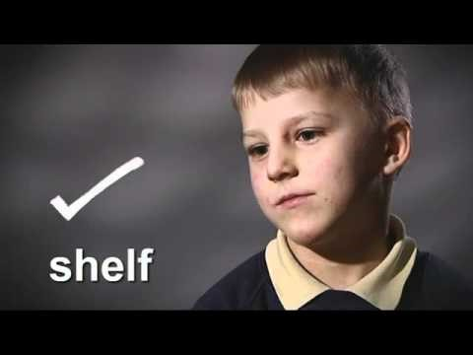
Screening check video.
https://www.youtube.com/watch?v=IPJ_ZEBh1Bk

Slide 16
June 2019 results
Pass mark was 32/40
Our school- 90%
Birmingham- 81%
Nationally- 82%

Slide 17
Reporting
Parents to be told their child’s score on the
end of year 1 report.
Teachers to report scores to DfE Assessment
Unit by July.
Children who have not reached the expected
standard will retake in June of Year 2.

Slide 18
Information pack
An example of a past phonics check
Useful websites to use at home
Sound mats for Phases 2-5 to support your child at home
Phase 2-5 Tricky Word lists

Slide 19
Questions

Slide 20
Thank you for your time and support.

