Slide 3
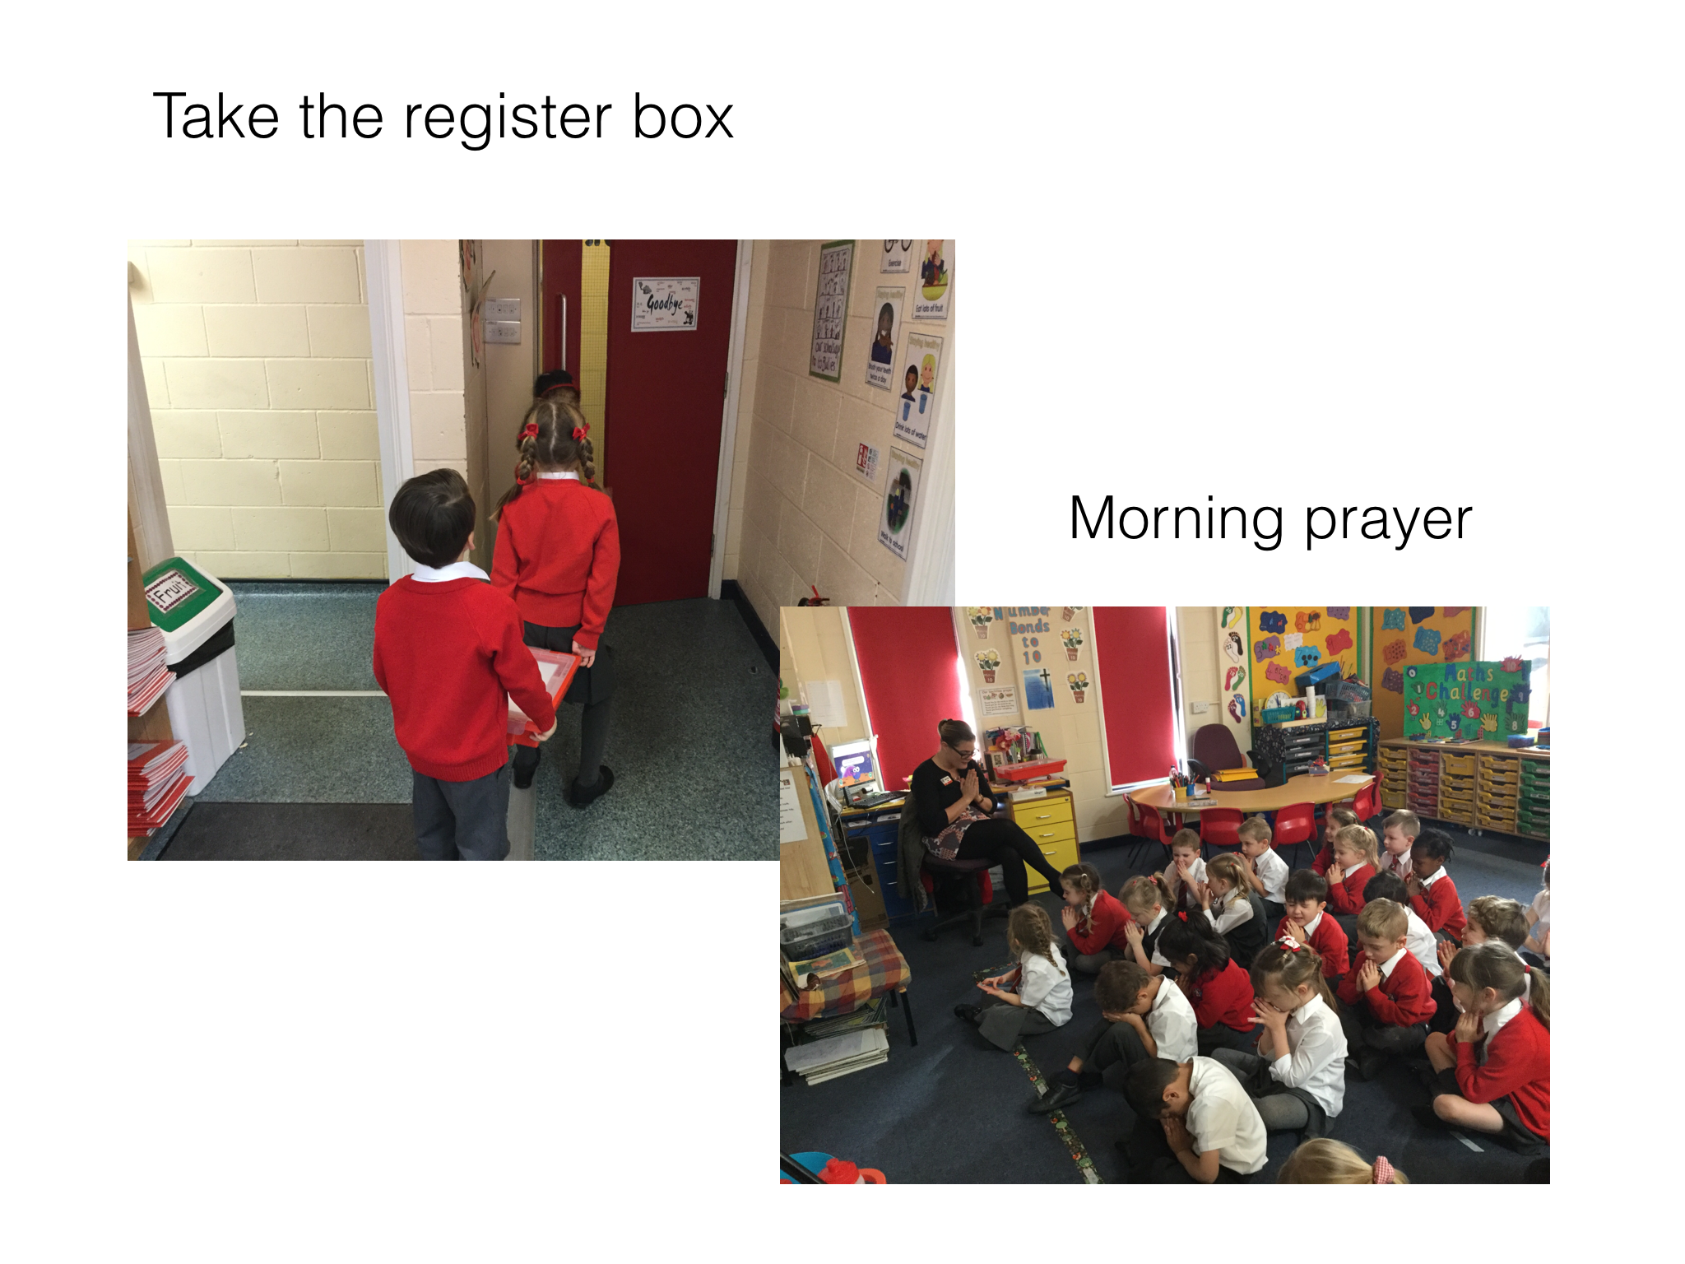

Slide 4
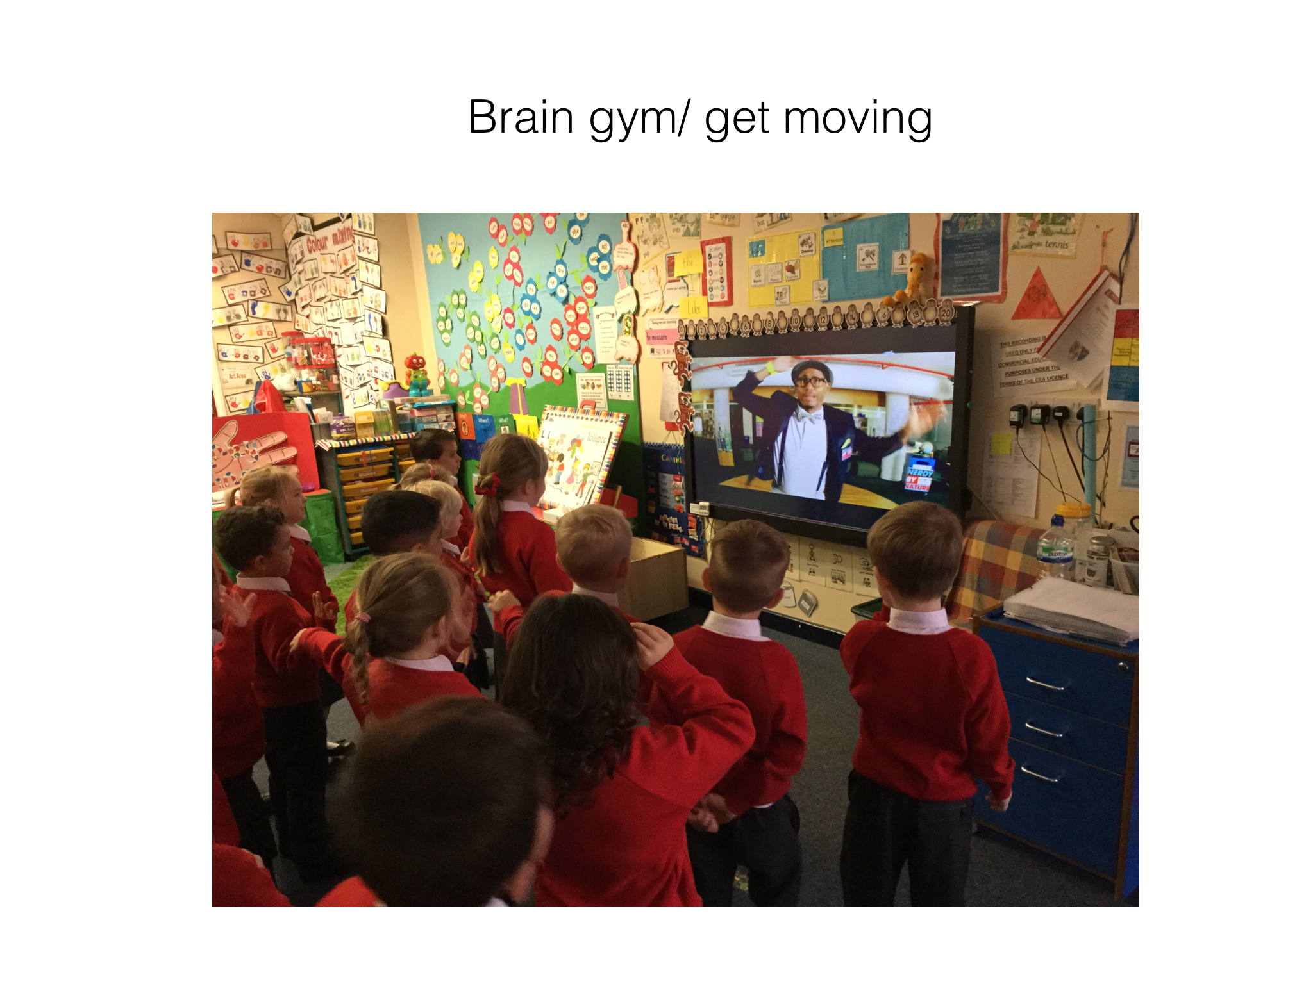

Slide 6
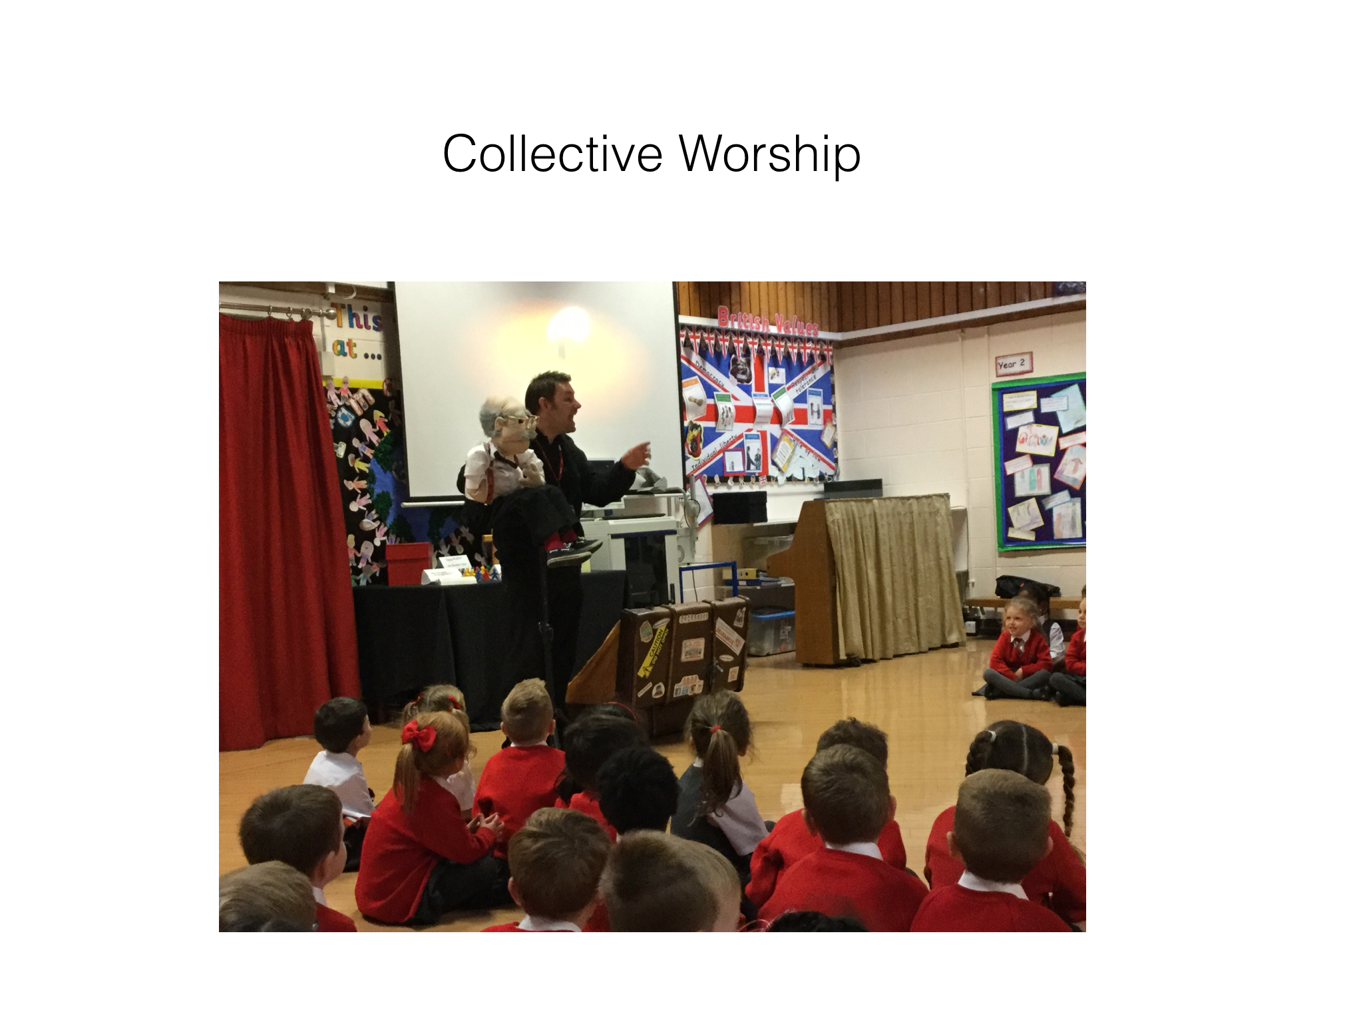

Slide 8
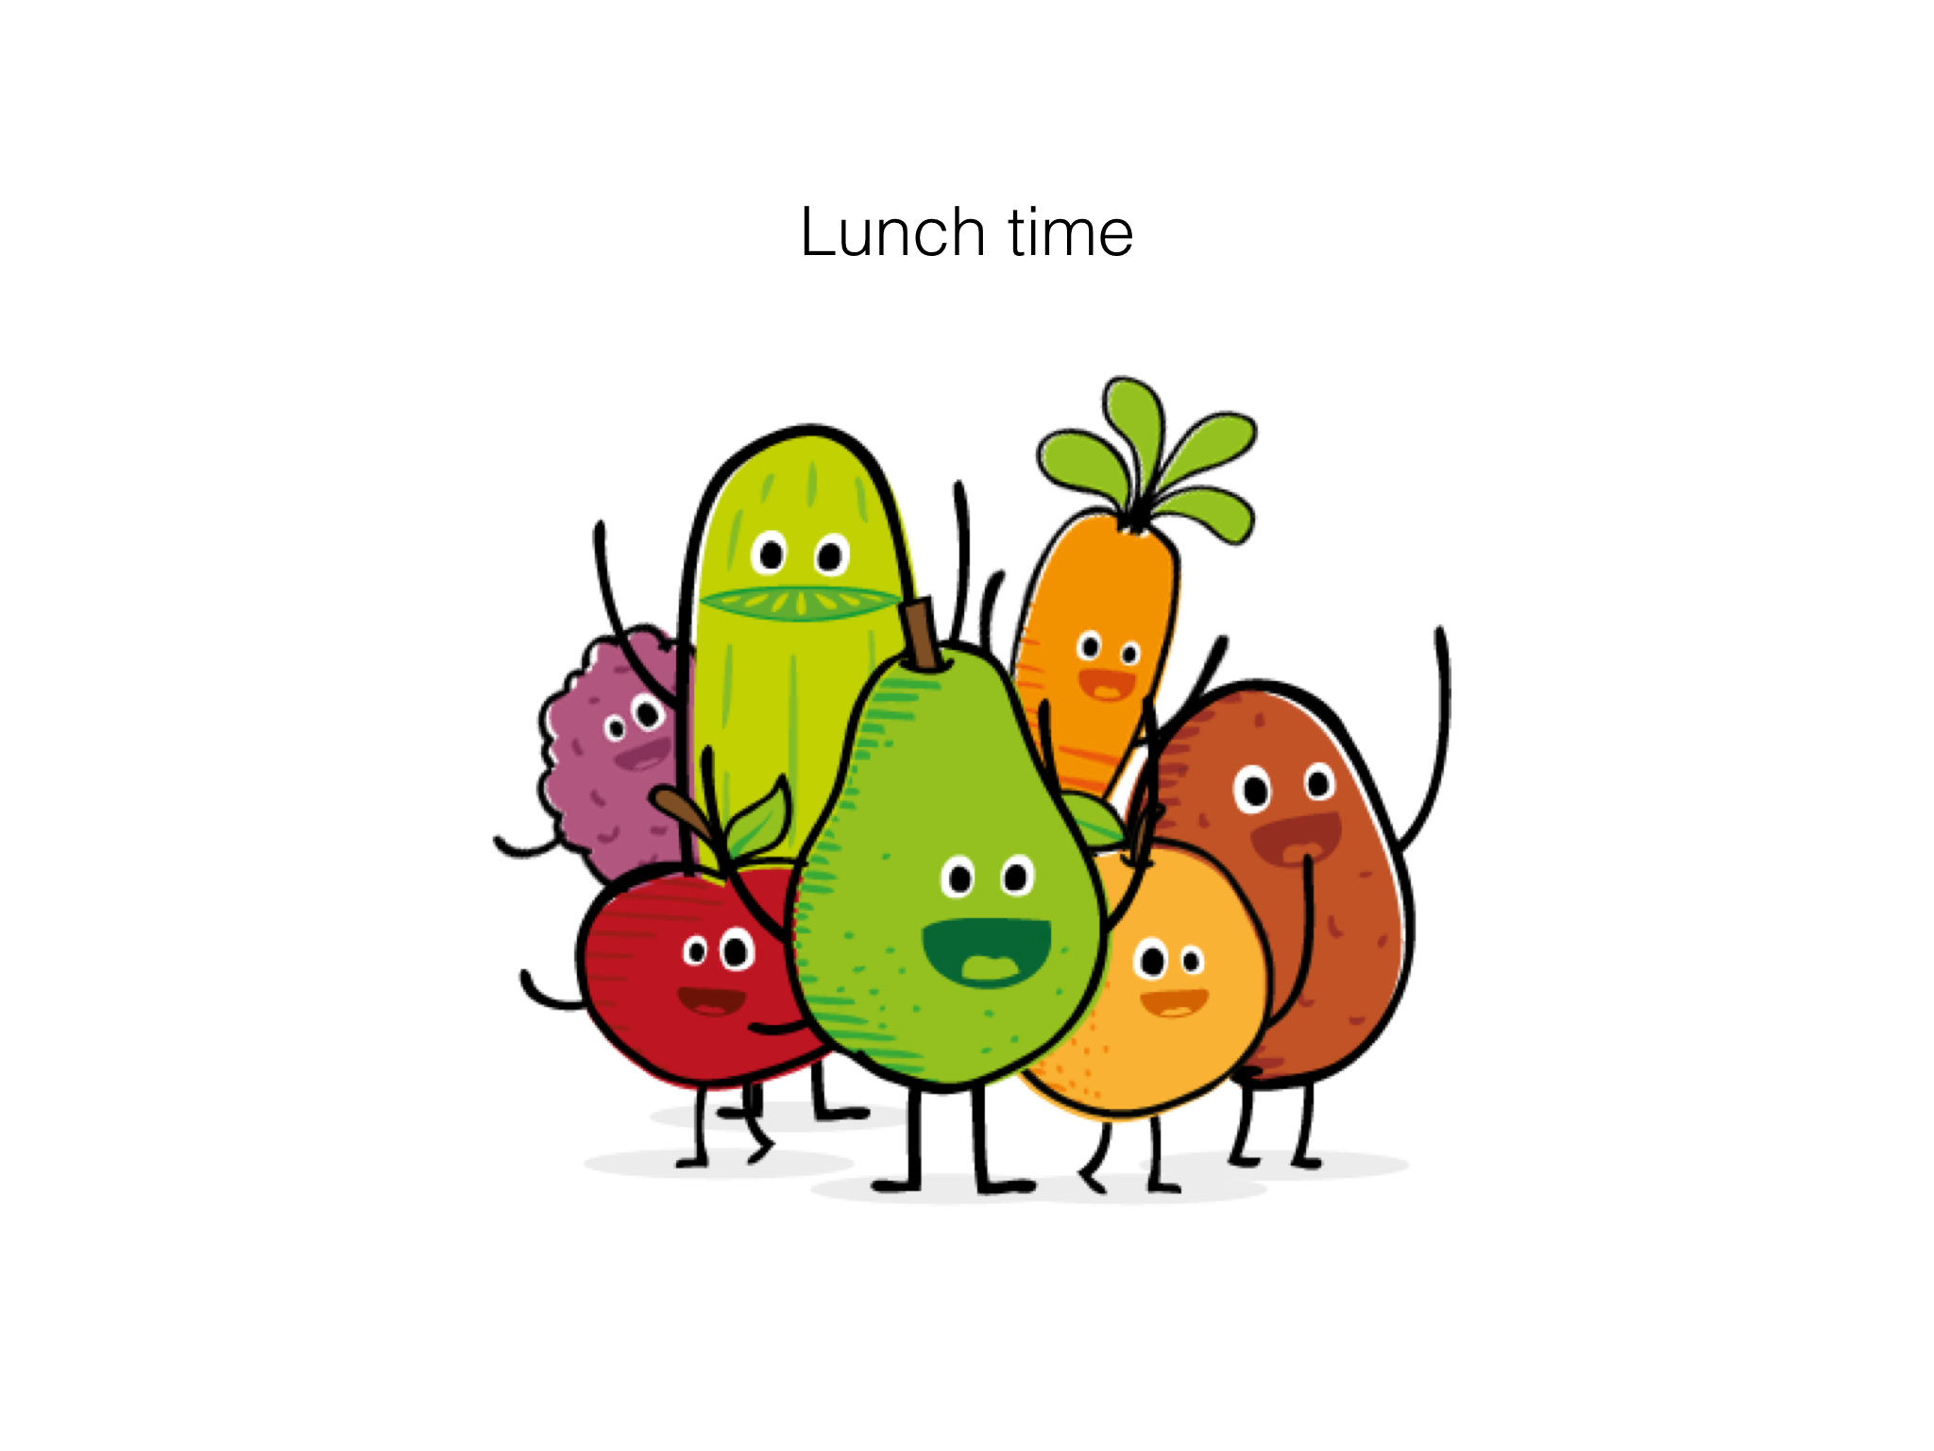

Slide 10
Daily phonics sessions
Daily maths sessions
2 focused P.E sessions a week
1 ICT session in the computer room
1 session of R.E
1 session of cooking
1 session of music

