Slide 1
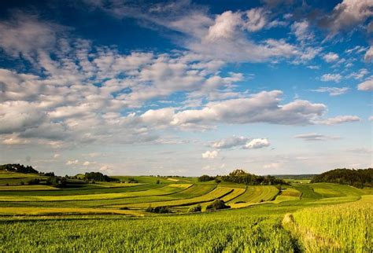
Life in all its fullness
John 10:10

Slide 2
We asked, “What does this mean to you?”

Slide 3
How do we live life in all its fullness at the Deanery?
How do we create opportunities?
Do children simply live up to our expectations?
Can we change our expectations? Can we therefore change potential?
The greatest impact on children in school are the adults that they come into contact with.
Happy, respected, valued staff have the greatest impact on children.
We can make a difference and see the potential in all our children.

Slide 4
What opportunities and experiences are children going to take with them?
Enrichment

Slide 5
The vision is underpinned by four key elements: Wisdom, Hope, Community and Dignity

Slide 6
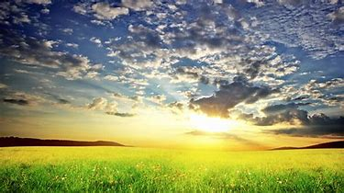
Life in all its fullness
Dignity
Community
Hope
Wisdom

Slide 7
We are all special to God. He notices us, everyone matters, we can hold our heads up with dignity
At school, we wanted to give all children the opportunity to be noticed and to be special. During Enrichment, teachers work with small groups of children which provides a special time to talk to each child, taking notice, listening, engaging and valuing each and every one. Teachers select an area of interest, a passion to share and enthuse children. Teacher’s talents are valued.
Dignity

Slide 8
God made us all to have friends. We are all good at something, but not everything, so we need each other to support each other as partners in learning.
Enrichment provides the opportunity for children to mix across year groups and make friends across school. We are able to share our skills within our school community, through enthusiastic talented teachers sharing skills to last a life time, but also to enable children to share their skills and talents given from God.
Community

Slide 9
God has big plans for all of us. If we fail, we can try again and have a new start whenever we need it.
Enrichment encourages resilience when trying new skills, to persevere and do your best.
Hope

Slide 10
Proverbs 24:3 By wisdom a house is built, and through understanding it is established
We inspire learning at school, but it is not necessary to be clever, but for children to be wise and to use knowledge in a good way, to the greater glory of God.
Enrichment provides opportunities for children to share their skills and to support each other, to practice being leaders of the future.
Wisdom

Slide 11
Enrichment
All children and staff involved
KS1
and reception small groups of 16 mixed age children
KS2 small groups of 18 children from y3 to y6
Timetable variation to allow 2 hour quality enrichment time
Engage, evaluate, report
Friday afternoon – lovely end to the week
Plan for 6 weeks, repeat over the year
Teach an area of interest – inspire, enthuse
Enjoy and be happy! Live life in all its fullness.

Slide 12
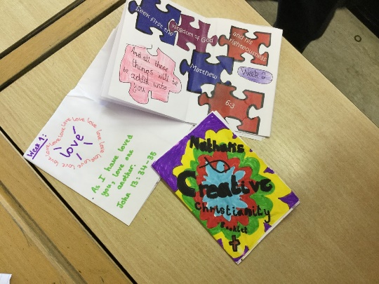
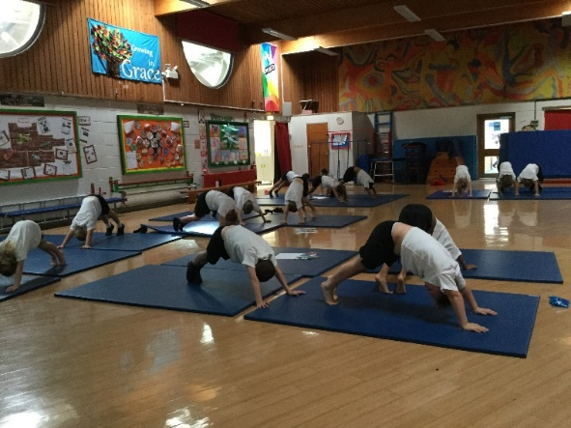
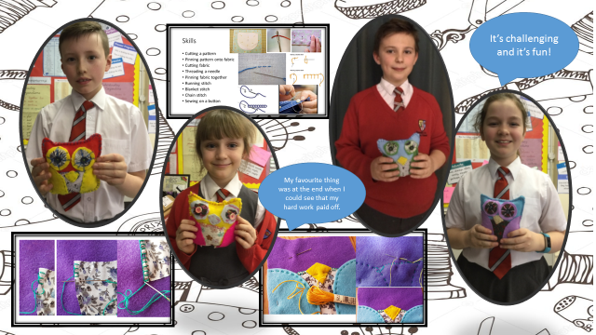
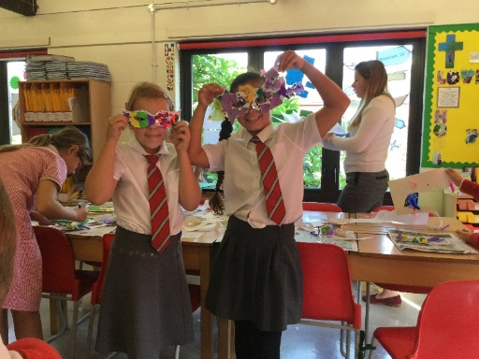
Pupil Voice
Creative Christianity
I like the dancing and craft. I like making the bible verse booklet and learning new bible verses. I have learnt more about the bible and the school values. I learnt that you can worship God in lots of ways. I’m proud of the Noah’s Ark and stained glass window that I made. I found the cutting tricky. We did lots of things like dance, drama, singing and craft.
Cooking
I enjoyed tasting new foods and making dishes using recipes. I made friends from other classes. I have been proud of eating food I have cooked. I have made banana bread, cake in a mug, pizza and I did a Deanery bake off and created my own cupcake. I found cracking an egg really tricky. You make amazing things and are trusted to do it on your own!
I enjoy the fact we are in small groups with mixed ages. I have learnt that you can worship God in lots of ways. My favourite thing was the Andrew Goldsworthy art. I found some bible verses tricky. I am proud of the worship dance and learning new things about God. I like working with our visitor Lydia.
Drama
I liked having fun, meeting new people and making new friends. I have learnt about voice control, facial expressions and learnt how to express myself. I like its not like usual lessons and we are trying something new. I have learnt its not as easy as it looks and you have to work at it. I could be an actor one day!
Photography
I have learnt new skills that are interesting. I have learnt about angles and how to crop photos and use new settings on the ipad. I have been inspired in photography am proud of my editing. I am proud of the photos. I have made and using a real camera. I enjoyed taking photos of crickets and having a professional photographer teach us.
Teamwork, Friendship, New skills, New experiences, Inspired, Fun, Challenging, Trusted, Different classes, Completely different to the rest of the week
Sewing
I have enjoyed learning how to sew a button on and do backstitch, chain stitch and running stitch. I have learnt how to thread a needle. I am proud because I made my own toy. My favourite thing was stuffing my owl and at the end when I could see my hard work had paid off. Stitching is tricky and challenging but fun!

Slide 13
Next steps
Children select types of activities available – through councils?

