Slide 1
E-Safety Parents’ Evening
Thursday 3rd May 2018

Slide 2
E-Safety Parents’ Evening
What do children do online?
What are the risks?
E-safety at the Deanery
PCSO Florence – children’s workshop, real life examples etc.
Findings of the Children’s Commissioner report into social media use among 8-12 year olds.
What can parents do at home?
Questions

Slide 3
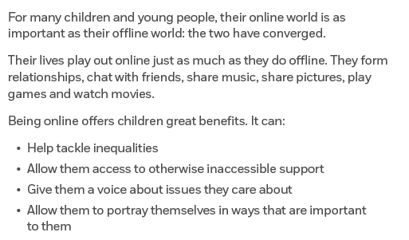
What do children do online?
8-11 year olds spend 11.1 hours a week online.
12-15 year olds spend 18.9 hours a week online.

Slide 4
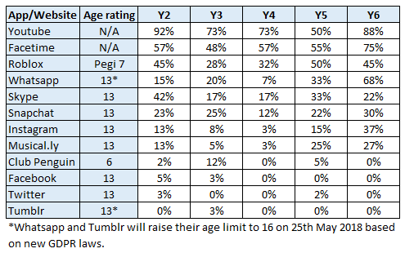
What do Deanery children do online?
Children are most likely to use tablets to access the internet, but many have their own phones and laptops.

Slide 5
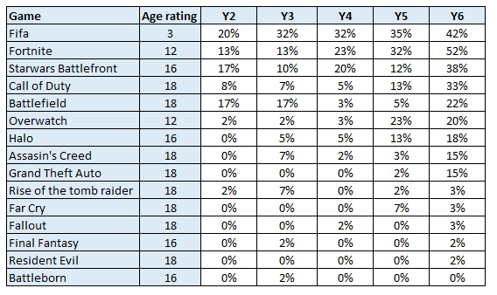
What do Deanery children do online?
Upwards of 42% of children have games consoles (75% in Y6)
Many children play multiplayer games online which can involve messaging others or speaking over headsets.

Slide 6
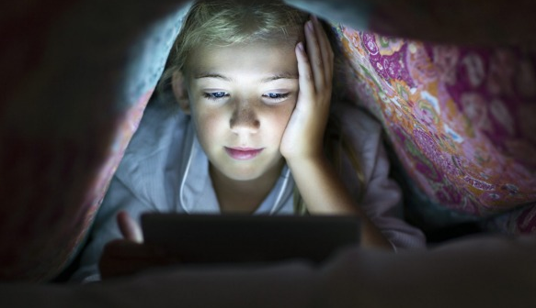
What do Deanery children do online?
Between 53% - 70% of children keep devices with them at night.
Many children said that they use these to go online after they’ve been asked to go to bed. (Messaging friends, playing games – most watching YouTube videos)
Notes:
We have had incidences of children messaging and facetiming each other at 1 or 2 am – some children complain of being too tired for school and when asked why, some say that they were up late watching youtube videos etc.

Slide 7
Risk and harm
Children will take risks, so there is a need to find a balance between this behaviour and keeping them safe online.
Risk taking is part of child development and connected to our desire to learn and succeed.
As children take risks, they are inevitably exposed to more harm.
Risk taking needs to be viewed in the context of each individual child and their levels of maturity, development and resilience.
The presence of risk does not always mean there will be harm.
Notes:
The level of exposure to risk and likelihood of harm taking place depends on access to technologies, levels of education, age and maturity, levels of protective support from adults.
If we can talk to our children about risks online, and equip them with the knowledge of what to do and how to behave it will be far less likely that they will experience harm.

Slide 8
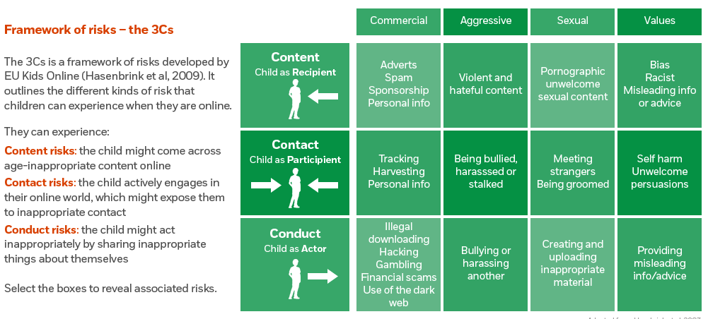
What are the risks? – The 3Cs
Notes:
Children are sometimes presented with risks online but they are not always easy to identify because the environment is less familiar, social cues are less obvious and the same safeguards don’t exist. As adults, when we find these risks harder to decipher we aren’t able to protect children in the same way as we would in the offline world.

Slide 9
What are the risks?
Accessing online pornography (accidentally or out of curiosity)
Accessing violent content (YouTube videos, games, etc)
Accessing biased or extreme opinion websites (encouraging eating disorders, self-harm and suicide)
Radicalisation and extremism
Sexting/Sharing inappropriate content
Sexual abuse (contact/non-contact)
Online bullying (known or anonymous)
Notes:
Recently completed an e-safety course delivered by the NSPCC and CEOP. They explained the main risks faced by children are:
Pornography – most don’t seek it out and most will be blocked if you set filters but nothing is 100% perfect. Children will be more likely to seek it out as they are older.
Violent content is most often viewed in games – 8 of the most popular games played by Deanery children are rated 18.
Extreme websites – children are more at risk in secondary school but children are befriended and encouraged to harm themselves.
Sexting is defined as when children share nude or nearly nude images of themselves or others or they message others with sexual content. If they share images of under 18 year olds, even of themselves they would be breaking the law. If it is with malicious intent they could face criminal proceedings as part of the Protection of Children Act 1978.
Sexual abuse can be contact or non contact – children are encouraged to take images or videos of themselves and send them to others, they can then be used as blackmail. Meet ups.
Online bullying most frequent – fall outs, children impersonate each other, send anonymous messages etc.

Slide 10
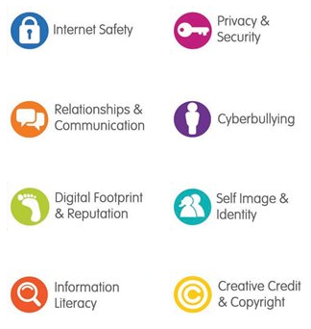
E-Safety at Deanery
Content is filtered through our BGfL system.
Inappropriate words as text or images are flagged up to SLT.
Reporting system for inappropriate content.
Embedded throughout the curriculum.
Internet Safer Day every February.
Visits from outside providers (bCyberwise and the police)
New e-safety units being written for Y1-Y6

Slide 11
Police E-Safety Workshops
June 27th, 28th and 29th
Y1-Y6
Delivered by PCSO Florence from the Change Team.
PCSO Florence has been delivering school inputs for over 12yrs covering: Stranger Danger, Antisocial Behaviour, Child Exploitation and Online Protection, Knife Crime and Road Safety.
Notes:
PCSO Florence from the Change team will be coming in to deliver e-safety workshops to Y1-Y6 at the end of June.
He is going to talk you through what he will go through with the children now and will be around for questions at the end.

Slide 12
Children’s Commissioner report – Social media use among 8-12 year olds
Looked at the impact of social media on the wellbeing of 8-12 year olds.
Findings:
As children get older they use social media multiple times a day and for some it dominates their day.
They enjoy keeping in touch, sharing media and supporting each other.
‘Sharenting’
Children more likely to see mean comments from others.
Keeping up with others – likes, friends, snapstreaks…
Children torn between staying authentic but also wanting to fit in – wanting to look cool and post pictures that people will like.
Following celebrities – unattainable lifestyle comparisons.
Are children resilient enough to withstand this? Mental health and wellbeing.
Notes:
As children get older they use social media multiple times a day and for some it dominates their day.
They enjoy keeping in touch, sharing media and supporting each other.
‘Sharenting’ – many children feel uncomfortable and bothered by parents posting pictures of them on social media and felt they could do little to stop it.
Children more likely to see mean comments from others. Confusion around ‘blurring’ of jokes posted publicly.
Children torn between staying authentic but also wanting to fit in – wanting to look cool and post pictures that people will like.
Following celebrities – unattainable lifestyle comparisons.
If children aren’t resilient – social media can have a detrimental effect.

Slide 13
What can parents do?
Understand why children go online and how they use apps and websites.
Keep up to date with services children are using – family discussions/useful links.
Manage risks by setting restrictions – consoles, apps, google safe search, YouTube, (useful links)
If children have social media accounts, ensure these are set to private.
Set screen time allowances if necessary (Our pact app, moment app) & encourage children to disengage.
Be aware of ‘sharenting’, especially with older children.
Most importantly, talk…

Slide 14
What can parents do?
Encourage children to have ongoing open and honest discussions about the apps, social networks and websites they use. Ice breakers available.
Agree with your children which are ok or not ok for them to use and explain why.
Set boundaries that are agreed by everyone, such as times they are allowed online and what they are allowed to do. Family agreement templates available.
Consider setting rewards if they stick to agreements and allow children more freedom as they mature and develop.
Try not to overreact if children make mistakes online.
Reassure them that they can always talk to you about what they do and see online.
Discuss real life vs social media life. Help children to see the difference and realise that they should try not to make comparisons.
Be flexible - allow children more freedom as they demonstrate their maturity and resilience online.

Slide 15
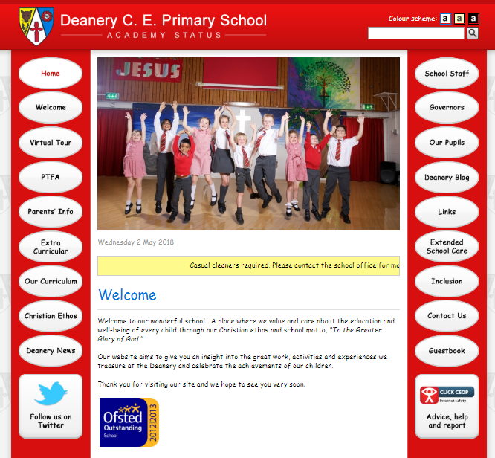
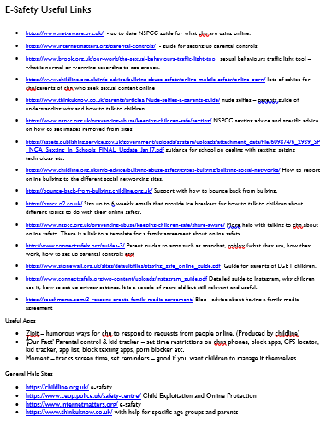
Resources on our website
Notes:
Useful resources on our website
CEOP button on the bottom right of each page (currently pointing to incorrect link, have asked our website man to change)
Parent info -> Esafety you’ll find this presentation, useful links and more.

Slide 16
Questions?

Slide 17
Thank you
Thank you for joining us.
Please fill out an evaluation form.
If you have any questions or worries, please email school/see me after school.

