Slide 1
Curriculum Meeting
Year 3

Slide 2
Year 3 Timetable English and Maths
English is taught daily. This is taught throughout the week as: Guided Reading, Grammar, Comprehension, SPAG, Writing, Spelling, Dictation and Handwriting.
English is also part of other subject areas such as R.E. Science and Creative Curriculum.
Maths is taught daily. Children start by completing a short ‘Settling Down’ task and then move on to the main focus of the lesson.

Slide 3
Maths
Settling down activity - Differentiated task 1* 2** 3***
Calculation policy
Fluency, Reasoning, Problem solving examples
X tables x3, x4, x8 beat the clock – scores recorded by pupils themselves – aim is to beat their previous score
Tasks are set to meet the pupils needs in terms of ability. Children are encouraged to challenge themselves, often having opportunity to choose which level they would like to work at.

Slide 4
Calculations policy
Please look at the handouts provided, outlining the calculations policy in Year 3.
Addition, subtraction, multiplication, division

Slide 5
English
Settling down task
Terminology glossary
In English books – Year 3/4 Common exception word lists/word banks/targets
Spelling – Weekly spelling patterns – tested and taught, dictation and editing activities weekly
Spelling – pupils record own scores which are then noted by teacher in order to track progress
Joined handwriting
SPAG practise session followed by writing session

Slide 6
English
The list of common exception words for Year 3 and 4 are in your pack.
Suggested games to help your child to learn spellings.
Ideas for engaging children in reading

Slide 7
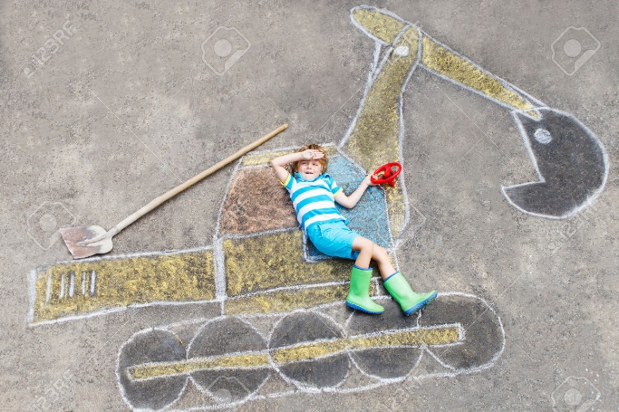
Other Subjects
R.E. Science, Creative Curriculum, ICT, Music P.E. and Spanish make up the rest of the curriculum and are taught according to the requirements of the National Curriculum.
Enrichment allows the children to explore creativity on Friday afternoons from
1:30 – 3:30pm.

Slide 8
Homework
Children are expected to complete H/W tasks on a weekly basis, to support their learning in school. Blue Book (English) 3 week rota of a grammar task, a comprehension task and a written task
Blue book take home on Tuesday – complete and hand in by following Monday PW
Blue book take home on Wednesday – complete and hand in by following Tuesday CC
Reading (Daily)
Maths – My Maths Task – linked to weekly learning in Maths
TTRockstars – self testing in form of games – tables set to match ability (progressive)
Weekly Spelling test – Tuesday 3W/ Wednesday 3C

Slide 9
Parents – Reading Diary
Please hear your child read as often as possible and sign the diary to say that you have heard them read. This is another form of communication for parents to write messages about your child’s learning or homework. We endeavour to keep the line of communication open as we realise that it is not always easy to speak to the teacher before or after school. Diaries are stamped by teachers on Monday.
Please check your child’s diary each evening to see the types of questions that they are working on in Maths. There will be a simple Maths question linked to learning.
Diaries need to be in school everyday.

Slide 10
Celebrations
‘Celebration Assembly’ is on Thursday. This is your chance to celebrate the good work that your child has done in Year 3. All children will have the opportunity to share work in this assembly, throughout the year.
Notification via text for best work
School awards and assemblies:
3W class assembly – Thursday 11th Oct, Thurs 25th Oct Awards, Thursday 15th Nov Year3/5 celebration, Thursday 29th Nov Year3/5 celebration, Thursday 13th Dec Year3/5 celebration

Slide 11
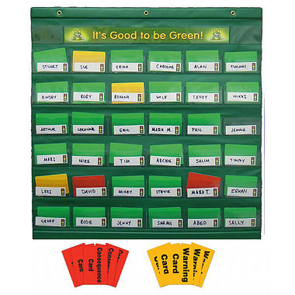
Rewards/Sanctions
Good to be green – warning system
This involves verbal warning, yellow card, red card. The yellow card can be removed if the child proves that they wish to amend their behaviour. If the yellow card still remains at the end of the day, or a child has received a red card, it is recorded on the school log. Red cards – letter sent home to parents.
X factor – “Move up the ladder” to receive a privilege card.
Privilege card reward – children have decided on these privileges.
Golden time weekly to reward good behaviour.

Slide 13
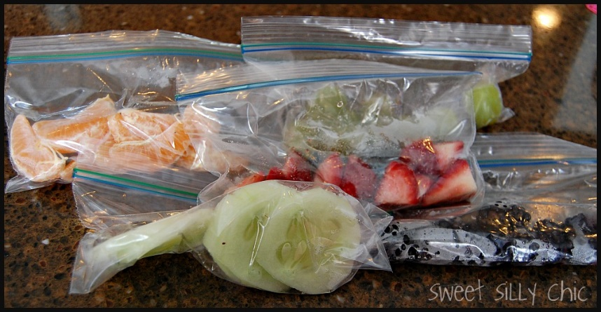
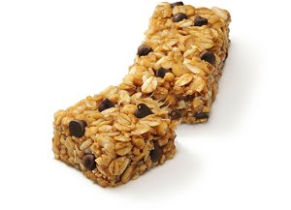
Snacks
Children can bring in a healthy snack to eat at the 11am break time.
Water bottles are kept in the classroom for children to access at all times. Please make sure the bottle is named.

Slide 14
P.E.
P.E. – Mon (Basketball) (outdoor) / Tues (Football) (outdoor)
Aut 2 Mon – dance Tues - gymnastics
Please provide your child with the correct kit for these days and make sure it is clearly labelled.
A letter will be sent home if your child is missing part of their kit.

